Slide 1

Health Insurance Application
Health
Insurance Application
Digitalization
of Business Process
Florian Büttiker
Oliver Freiermuth
Karimi Moahammad Ali
Pasquale Biafora

Slide 2
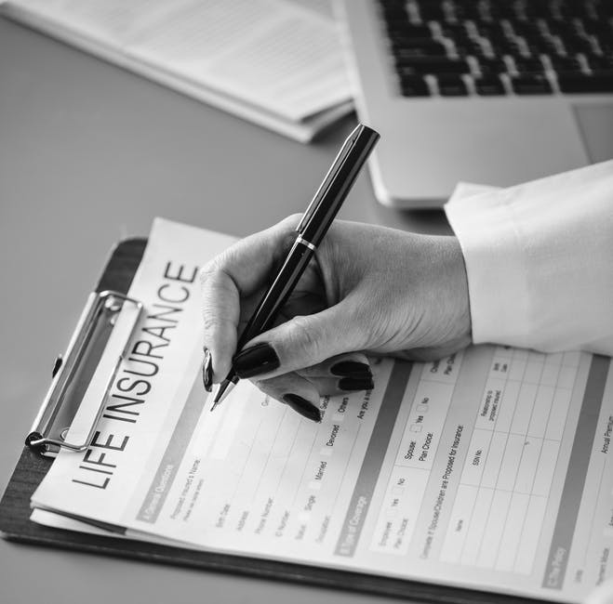
Agenda
AS-IS Situation
Customer Experience
Digitalized Process
Comparison
Demo
Questions
6/6/2018
2

Slide 3
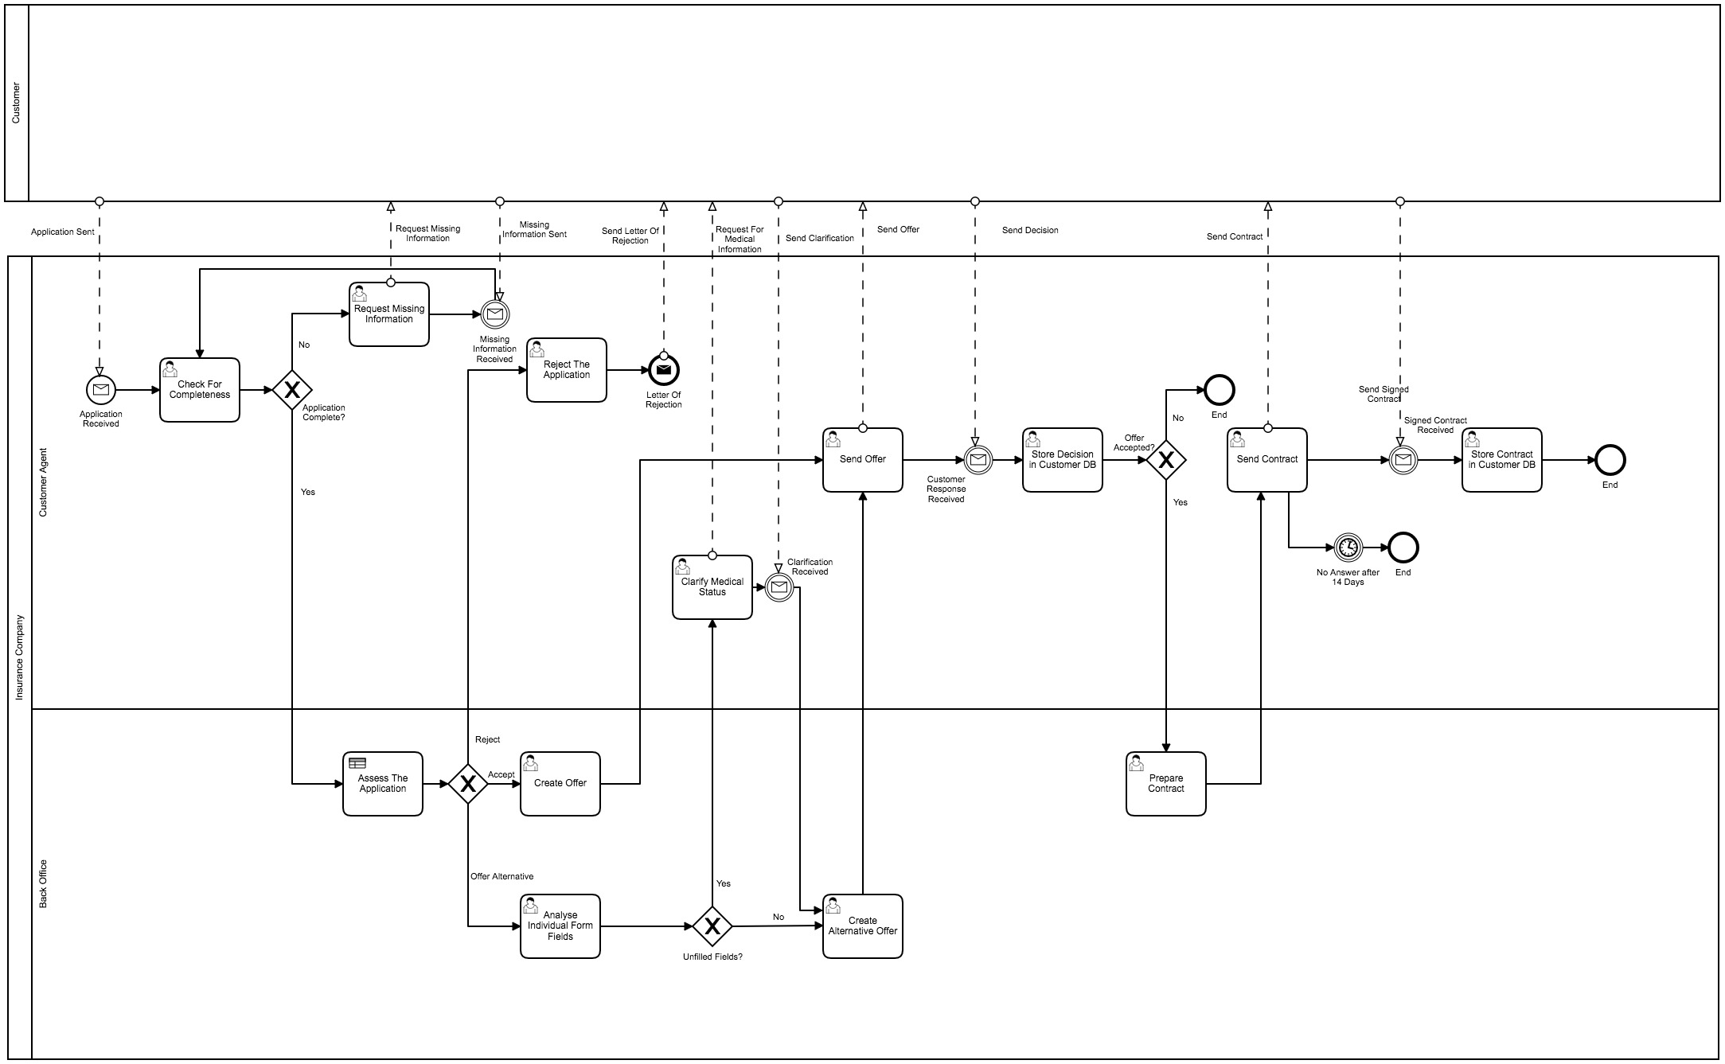
AS-IS Situation
6/6/2018
3

Slide 4



Customer Experience
Individual consultancy
Personal Interaction
Only offline communication
No traceability
Speed
Many mistakes (decision table is applied manually)
6/6/2018
4

Slide 5
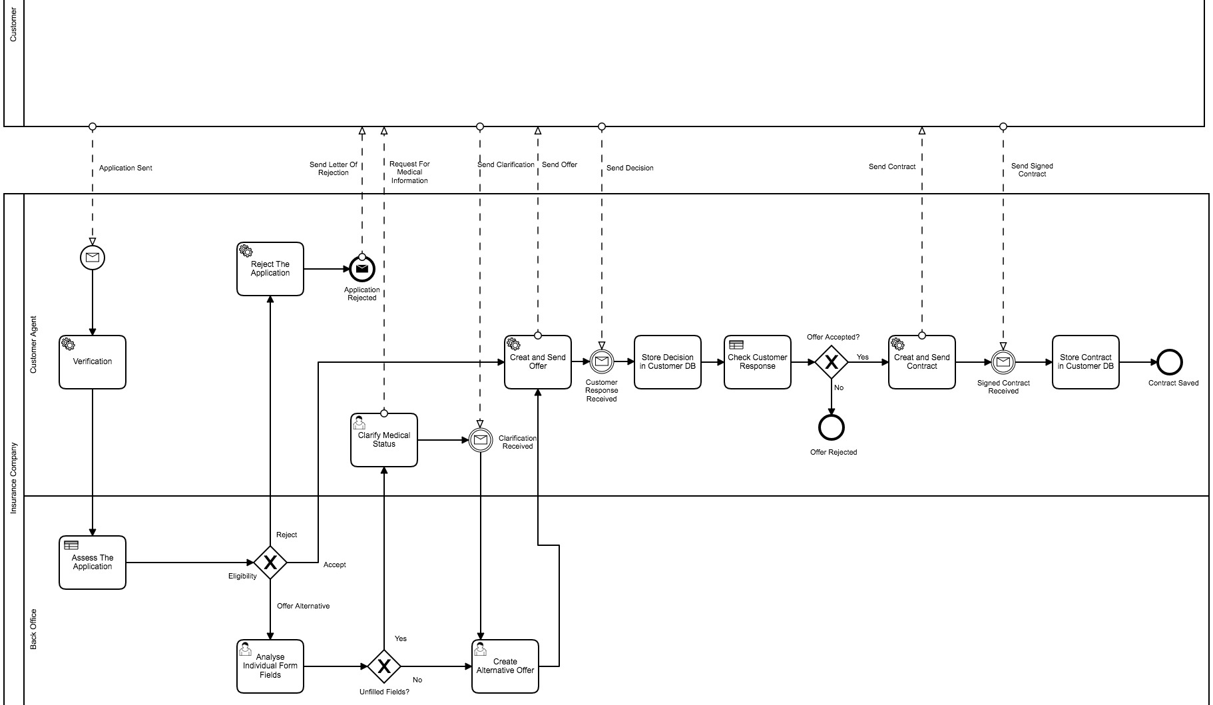
Digitalized Process
6/6/2018
5

Slide 6

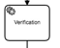
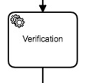


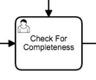
Comparison
Mostly automated script tasks
No media breaks
Elimination of unnecessary tasks (e.g. data check)
Online-Process (24/7)
6/6/2018
6

Slide 7

Demo
Picture source: Own Illustration
6/6/2018
7
6/6/2018
7

Slide 8

Questions

Slide 9

Thank you for your attention.
6/6/2018
9

Slide 10
Source citation
All pictures are from: https://www.pexels.com/
All icons are from: https://www.flaticon.com/
6/6/2018
10
6/6/2018
10

